Slide 1
Children’s Children A Biblical Vision for Generational Faithfulness
July 2014 CC

Slide 2
Proverbs 17:6
Children’s children are the crown of old men,
And the glory of children is their father.
2

Slide 3
Outline
Family vs. World evangelism
State of the modern family & How did we get here?
What is biblical family life and family directives?
Biblical vision for generational faithfulness
Practical, biblical application “Bring them up in the training and admonition of the Lord”
Purpose: Cast a biblical vision for our young and old alike for raising faithful generations until Christ returns

Slide 4
Where Do Christians Come From?
3 Choices
Family evangelism
World evangelism
Rock regeneration (Matt 3:9)
Haven’t seen #3 personally; can’t contribute anyways
Our evangelistic priority depends on station and calling
Married parent
Single parent
1 Cor 7:32 …He who is unmarried cares for the things of the Lord, how he may please the Lord. 33But he who is married cares about the things of the world, how he may please his wife.
Grandparent
Single, no children
4

Slide 5
Who Should Parents Evangelize First?
Both Jesus and Paul started with the Jews (Matt 10:5 & Rom 1:16)
Matt 10:5 These twelve Jesus sent out and commanded them, saying: “Do not go into the way of the Gentiles, and do not enter a city of the Samaritans. 6But go rather to the lost sheep of the house of Israel.
Rom 1:16 For I am not ashamed of the gospel of Christ, for it is the power of God to salvation for everyone who believes, for the Jew first and also for the Greek.
Biblical precedent to evangelize our own first
Qualification for elders is faithful children
Titus 1:6 …the husband of one wife, having faithful children... 1 Tim 3:4 one who rules his own house well, having his children in submission with all reverence

Slide 6
God’s Intent
God’s intent is for families to raise godly offspring.
Hosea 5:7 They have dealt treacherously with the LORD, For they have begotten pagan children. Now a New Moon shall devour them and their heritage.
Malachi 2:15 But did He not make them one, Having a remnant of the Spirit? And why one? He seeks godly offspring. Therefore take heed to your spirit, And let none deal treacherously with the wife of his youth.
6

Slide 7
State of the Modern Family
General disintegration of the family (church not much help)
Cohabitation rates increasing (~50%)(i.e. marriage becoming more irrelevant)
Children are now viewed companions, social status and…expensive
Children not respectful, obedient, polite, basic manners
1 in 3 children live without fathers (U.S. census)
70% of men are not grown up by 30 (up from 30% in 1970; News Week 2008)
Pornography addiction rate for men: 68%; marketing to children
0.5% young people (18-25) hold a Christian worldview compared to 14% in the previous generation (Barna poll)
97% of children raised in Christian homes turn away from the faith
7

Slide 8
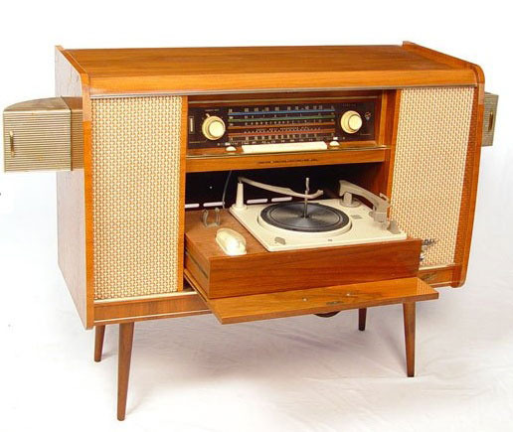
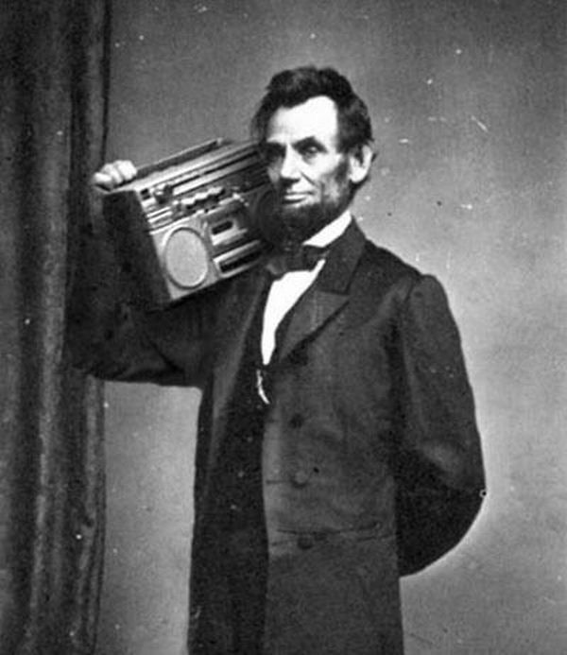
Culture Matters…alot
Culture of individualism
“Have it your way” BK
Personal size products abound
Denny’s story
It’s all about me
Technology making it easier →
Prov 18:1 A man who isolates himself seeks his own desire; He rages against all wise judgment.
Culture of entertainment
Escapism (virtual reality)
Influence
Healthy families compete with this culture
8
Notes:
Individualism: “Be your own person”, We are engrossed with ourselves, story about the 4 men bowing their heads at Dennys…turns out they were on their iphones
Existentialism: Self absorbed, World revolves around me, having an experience that is all about self and neglects all others

Slide 9
How did we get here?
We live in a fallen world ever since Eden
We’ll focus more on the last 300 years – Modern Humanism
2 Cor 2:11 lest Satan should take advantage of us; for we are not ignorant of his devices.
Many “great” philosophers influential to humanism
Thomas Aquinas (1225-1274) – two areas of knowledge
John Locke (1632-1704) – theology
Jean-Jacques Rousseau (1712-1778) – society, anti-family
Karl Marx (1818-1883) - political state, anti-family
Charles Darwin (1809-1882) – science
John Dewey (1859-1952) – education, anti-family
Jean-Paul Sartre (1905-1980) – culture, anti-family

Slide 10
Humanism Defined
Google Definition
An outlook or system of thought attaching prime importance to human rather than divine or supernatural matters. Humanist beliefs stress the potential value and goodness of human beings, emphasize common human needs, and seek solely rational ways of solving human problems.
Who needs God, I’ve got it under control.
Col 2:8 Beware lest anyone cheat you through philosophy and empty deceit, according to the tradition of men, according to the basic principles of the world, and not according to Christ.

Slide 11
What is Biblical Family Life
How is the family spoken of in the scriptures?
Exodus 20:8 “Remember the Sabbath day, to keep it holy. ⁹Six days you shall labor and do all your work, ¹⁰but the seventh day is the Sabbath of the LORD your God. In it you shall do no work: you, nor your son, nor your daughter, nor your male servant, nor your female servant, nor your cattle, nor your stranger who is within your gates.
Deut 12:12 And you shall rejoice before the LORD your God, you and your sons and your daughters, your male and female servants, and the Levite who is within your gates, since he has no portion nor inheritance with you.

Slide 12
What is Biblical Family Life
Lev 10:14 The breast of the wave offering and the thigh of the heave offering you shall eat in a clean place, you, your sons, and your daughters with you; for they are your due and your sons’ due, which are given from the sacrifices of peace offerings of the children of Israel.
Deut 6:7 You shall teach them diligently to your children, and shall talk of them when you sit in your house, when you walk by the way, when you lie down, and when you rise up.
Gen 7:1 Then the Lord said to Noah, “Come into the ark, you and all your household…”
Acts 16:31 “Believe on the Lord Jesus Christ, and you will be saved, you and your household.”… And immediately he and all his family were baptized.
12

Slide 13
Biblical Family Life cont.
Families work and rest together (Ex 20:9)
Families rejoice together (Deut 12:12)
Families worship together (Deut 12:12, Lev 10:14, 1 Cor 16:15)
Families educate together (Deut 6:7)
Families are saved together (Gen 7:1 Noah, Ex 12:3 passover, Josh 6:25 Rahab, Acts 16:31 Phil jailer)
“household/s” occurs 116 times and people are often dealt with as whole households

Slide 14
Biblical Family Directives
God is not unclear on family expectations
Elders & deacons rule their houses well (1 Tim 3:4, 12)
Widow’s children & grandchildren provide aid (1 Tim 5:4,16)
Provide for one’s own household (1 Tim 5:8)
Younger widows marry and bear children (1 Tim 5:14)
Older generation admonish the younger to have Godly homes (Titus 2:1-8)
Marriage and children (Col 3:18-21, Eph 6:1-4)
Eph 6:4 And you, fathers, do not provoke your children to wrath, but bring them up in the training and admonition of the Lord.
Training: instruction, education
Admonition: call attention to or give a warning
Ephesians 6:4 = Generational evangelism

Slide 15
Biblical Examples of Generational Admonitions
Abraham – 1st mention of generational faithfulness
Gen 18:19 For I have known him, in order that he may command his children and his household after him, that they keep the way of the LORD…
Joseph – 110yrs old, just before dying
Gen 50:23 Joseph saw Ephraim’s children to the third generation. The children of Machir, the son of Manasseh, were also brought up on Joseph’s knees. ²⁴And Joseph said to his brethren, “I am dying; but God will surely visit you, and bring you out of this land to the land of which He swore to Abraham, to Isaac, and to Jacob.”
Joseph is passing the torch, casting a vision, confirming the promises, outlining the mission across 4 generations.

Slide 16
TELL Your Children!
Joel 1:1 The word of the LORD that came to Joel the son of Pethuel. ²Hear this, you elders, and give ear, all you inhabitants of the land! Has anything like this happened in your days, or even in the days of your fathers? ³Tell your children about it, let your children tell their children, and their children another generation.
Tell your children about what God has done. REMEMBER! (Psalms 78)
God makes memorials for a reason.
Lay out a plan to have them do the same…perpetually
200yr plan requires passing the baton and the goal
We are not just raising Christian children, we are part of God’s long term mission of saving the world

Slide 17
Teach them Diligently to Your Children
Deuteronomy 6:4 “Hear, O Israel: The LORD our God, the LORD is one! ⁵You shall love the LORD your God with all your heart, with all your soul, and with all your strength. ⁶“And these words which I command you today shall be in your heart. ⁷You shall teach them diligently to your children, and shall talk of them when you sit in your house, when you walk by the way, when you lie down, and when you rise up. ⁸You shall bind them as a sign on your hand, and they shall be as frontlets between your eyes. ⁹You shall write them on the doorposts of your house and on your gates.
Evangelizing our families begins by evangelizing ourselves
Diligently: Heb ‘shawnan’ - to point, (figuratively) to inculcate (to instill by persistent instruction) (Pound it…)
We can NOT be assuming or indifferent to our children’s life training

Slide 18
Generation Overlap
Deuteronomy 4:5 “Surely I have taught you statutes and judgments… 6Therefore be careful to observe them; for this is your wisdom and your understanding…9Only take heed to yourself, and diligently keep yourself, lest you forget the things your eyes have seen, and lest they depart from your heart all the days of your life. And teach them to your children and your grandchildren
2 generation overlap is a safeguard against forgetting & forsaking God’s word
Parents have primary responsibility
Grandparents have a biblical responsibility to teach
This takes vision, humility, patience…on all sides
If not possible now, start planning for the next generation
Notes:
18

Slide 19
Joshua→Elders→…Baal worshipers?
Judges 2:7 So the people served the LORD all the days of Joshua, and all the days of the elders who outlived Joshua, who had seen all the great works of the LORD which He had done for Israel.…¹⁰When all that generation had been gathered to their fathers, another generation arose after them who did not know the LORD nor the work which He had done for Israel. ¹¹Then the children of Israel did evil in the sight of the LORD, and served the Baals;
Joshua 110yrs old when he died Josh 24:15 “all my household”
Complete 180 turn in ONE generation…Yikes!
No indwelling Holy Spirit at this time, but the admonishment is sobering
What happened to the 2 generation overlap?
Someone dropped the ball

Slide 20
More Generation Overlap
Ex 10:1 Now the LORD said to Moses, “Go in to Pharaoh; for I have hardened his heart and the hearts of his servants, that I may show these signs of Mine before him, ²and that you may tell in the hearing of your son and your son’s son the mighty things I have done in Egypt, and My signs which I have done among them, that you may know that I am the LORD.”
2 Tim 1:5 when I call to remembrance the genuine faith that is in you, which dwelt first in your grandmother Lois and your mother Eunice, and I am persuaded is in you also.
Timothy likely received his faith from 2 generations

Slide 21
Application
Eph 6:4 And you, fathers, do not provoke your children to wrath, but bring them up in the training and admonition of the Lord.
How do we apply this command?
Family worship
Children’s peers
Spouse selection

Slide 22
Family Worship (devotions, studies, time, etc.)
If we don’t enjoy worshiping God here on earth, why would we want to go to heaven? – Sam Dick
If we are not worshipping God Mon-Sat at home, why expect our children to be excited for Sunday?
O.T. shadow: Burnt Offering Lev 6:13 A fire shall always be burning on the altar; it shall never go out
Hebrews 13:15 Therefore by Him let us continually offer the sacrifice of praise to God, that is, the fruit of our lips, giving thanks to His name. ¹⁶But do not forget to do good and to share, for with such sacrifices God is well pleased.

Slide 23
Family Worship: A way of life?
Sunday gathering should be a natural extension of home worship
Do our families:
Hear the word at home?
Psalms 119:11 Your word I have hidden in my heart, That I might not sin against You.
Are we hiding the word in our and their hearts?
Inculcate!
Hear the gospel at home? (grace and truth, John 1:17)
Have the fear of God? (beginning of knowledge & wisdom)
God integrated life
Have spontaneous prayer and praise? (David moments!)

Slide 24
Psalms 145: A David Moment
¹ I will extol You, my God, O King; And I will bless Your name forever and ever.
² Every day I will bless You, And I will praise Your name forever and ever.
³ Great is the Lord, and greatly to be praised; And His greatness is unsearchable.
⁴ One generation shall praise Your works to another, And shall declare Your mighty acts.
⁵ I will meditate on the glorious splendor of Your majesty, And on Your wondrous works.
⁶ Men shall speak of the might of Your awesome acts, And I will declare Your greatness.
⁷ They shall utter the memory of Your great goodness, And shall sing of Your righteousness.

Slide 25
Peer Pressure or Seer Pressure?
Children should spend significant portions of time with their peers…or should they?
Prov 22:15 Foolishness is bound up in the heart of a child; The rod of correction will drive it far from him.
Bill Y’s theory…
Not that peer time is all bad
Prov 13:20 He who walks with wise men will be wise, But the companion of fools will be destroyed
Luke 2:46 [Jesus was found in the temple] sitting in the midst of the teachers, both listening to them and asking them questions.
Age: 12
Set some goals: age 4, 8, 12, etc. to be spending more time with adults
Notes:
Let’s draw a line in the sand with some goals for our children: age 4, ask grandpa what his favorite verse is, ask grandma what her grandma was like, etc. Age 8: shake hands with the elders and say “Hello, how are you today?”, Age 12: sit down with a parent, grandparent, elders to ask deeper spiritual questions “who is your favorite biblical person and why”, “Why was David a man after God’s own heart?” etc.

Slide 26
Who Should I Marry?
Gen 24:1 Now Abraham was old, well advanced in age; and the Lord had blessed Abraham in all things. 2So Abraham said to the oldest servant of his house, who ruled over all that he had, “Please, put your hand under my thigh, 3and I will make you swear by the Lord, the God of heaven and the God of the earth, that you will not take a wife for my son from the daughters of the Canaanites, among whom I dwell; 4but you shall go to my country and to my family, and take a wife for my son Isaac.”
Prior to his death, Abraham saw that his son married someone with the same vision

Slide 27
Who Should I Marry?
2 Cor 6:14 Do not be unequally yoked together with unbelievers.
Spouse selection is crucial!!! Do not take lightly!
Amos 3:3 Can two walk together, unless they are agreed?
Agreed – “to fix upon by agreement or appointment”
Pro 21:9 Better to dwell in a corner of a housetop, Than in a house shared with a contentious woman.
Pro 22:24 Make no friendship with an angry man, And with a furious man do not go
Marital discord is counter-productive in every area of life
Studies show happily married couples tend to be healthier and wealthier
Individualism is a marriage’s worst enemy!
27

Slide 28
Abundant Grace
What about single parent homes, orphans, divorce,…?
Gods grace is sufficient
Psalms 68:5 A father of the fatherless, a defender of widows, Is God in His holy habitation. 2 Cor 9:8 And God is able to make all grace abound toward you, that you, always having all sufficiency in all things, may have an abundance for every good work.
God provides in times of lack

Slide 29
God Gives the Increase
1 Cor 3:6 I planted, Apollos watered, but God gave the increase. 7So then neither he who plants is anything, nor he who waters, but God who gives the increase. 8Now he who plants and he who waters are one, and each one will receive his own reward according to his own labor.
Context: evangelism
Don’t be prideful; God is the one who changes hearts and makes them grow
However, there remains a promise: each one (parents) will be rewarded according to their labor

Slide 30
Reaping the Benefits
3 John 1:4 I have no greater joy than to hear that my children walk in truth.

