Slide 1
Genesis 4

Slide 2
Cain and Abel
Genesis 4:3 – 9 → The first murder
Cain (acquire) brought an offering of fruit of the ground to God
Cain was a tiller of the ground
Abel (breath) brought an offering of his flock
Abel was a keeper of sheep
God respected Abel and his offering but not Cain and his offering, and Cain gets angry
God tells Cain he will be accepted if he does well and to rule over the sin that lies at the door
Cain kills Abel in the field
Why did God respect Abel and his offering (vs. 4) but not Cain and his offering (vs. 5)?
Not told why
Verses state “…respected Abel and his offering,” and “…did not respect Cain and his offering.”
Hebrews 11:4 → “By faith Abel offered a better sacrifice than Cain,”
It could be that Abel’s faith is what made him and his sacrifice pleasing to God
Notes:
Literal interpretation of a day being a thousand years doesn’t work because this isn’t long enough for evolution

Slide 3
Cain and Abel
Genesis 4:6 – 7
Cain is angry because he was not accepted by God
Instead of repenting, he lets anger control him
God tells Cain to control himself
If you do well, you will be accepted, other wise sin is waiting to get you
Still true today → we cannot be ruled by our emotions, we must rule over our emotions and desires
Why did Cain kill Abel?
Genesis 4:5 → God did not respect Cain and his offering, and Cain became very angry
Likely killed Abel because he was jealous that God received Abel’s offering and not his offering
Notes:
Literal interpretation of a day being a thousand years doesn’t work because this isn’t long enough for evolution

Slide 4
The Blood of Abel
The blood of Abel seems to be held in high regard by the Jews
Genesis 4:10 – “…brother’s blood calls out to me…”
Matthew 23:35 – “…the blood of righteous Abel…”
Hebrews 11:4 – “…through which he obtained witness that he was righteous, God testifying of his gifts; and through it he being dead still speaks.”
Abel’s sacrifice showed he was righteous by God accepting it
It is still the example for righteousness even though he was killed
Jesus’ blood is better – Hebrews 12:24 – “…which speaks better than the blood of Abel.”
Abel was righteous, but his blood called out for judgment
Jesus was perfect, but his blood was offered for redemption of all
Notes:
Literal interpretation of a day being a thousand years doesn’t work because this isn’t long enough for evolution

Slide 5
Cain’s punishment for murdering Abel
Genesis 4:11 – 12
Cain was cursed from the earth
The ground would no longer yield its strength to Cain
Genesis 4:13 – 15
Cain says his punishment is too great
Shall be driven out and everyone will try to kill him
Genesis 4:15
God says whoever kills Cain shall receive vengeance sevenfold, and puts a mark on Cain so that none should kill him
Genesis 4:16
Cain went out from the presence of the LORD and dwelt in the land of Nod on the east of Eden
Even though they had left the garden of Eden (Gen 3:23-24), they still had access to the presence of God → Cain chose to leave this presence
Notes:
Thus "yom", in its context, is sometimes translated as: "time" (Gen 4:3, Is. 30:8); "year" (I Kings 1:1, 2 Chronicles 21:19, Amos 4:4); "age" (Gen 18:11, 24:1 and 47:28; Joshua 23:1 and 23:2); "always" (Deuteronomy 5:29, 6:24 and 14:23, and in 2 Chronicles 18:7); "season" (Genesis 40:4, Joshua 24:7, 2 Chronicles 15:3); epoch or 24-hour day (Genesis 1:5,8,13,19,23,31)

Slide 6
Cain’s Genealogy
Genesis 4:16-24
Lamech takes two wives
See the start of tent dwelling, musical instruments, bronze and iron craftsmen (vs. 20-22)
Next recorded murder in verses 23-24
Lamech killed a young man for wounding him
They still know of God’s decree to not hurt Cain (Cain could still be alive)
Takes it upon himself to make a decree like God did for Cain, but stronger
No indication this would be carried out though

Slide 7
Seth
Genesis 4:25 → Adam and Eve have another son and name him Seth (appointed)
Genesis 4:26b
“Then men began to call on the name of the LORD.”
Different possibilities for the meaning of this verse
Began calling upon God by His name
Began doing more in worship to God than they had previously been doing
Began formal sacrifices to God
Genesis 12:8 → “…built an altar to the Lord and called on the name of the Lord.”
A contrast of the lineage of Seth (through which Jesus comes) compared to the lineage of Cain that was just given
Some interpret this to say “to call themselves by the name of the LORD.” Then they say this refers to the start of idolatry

Slide 8
Genealogy – Genesis 5
Years from the creation of Adam to the birth of Noah
From Genesis 5 → 1056 years
Noah’s age when the flood occurred
Genesis 7:11 → Noah was 600 years old when the flood occurred
Therefore, the flood took place about 1656 years after creation

Slide 9
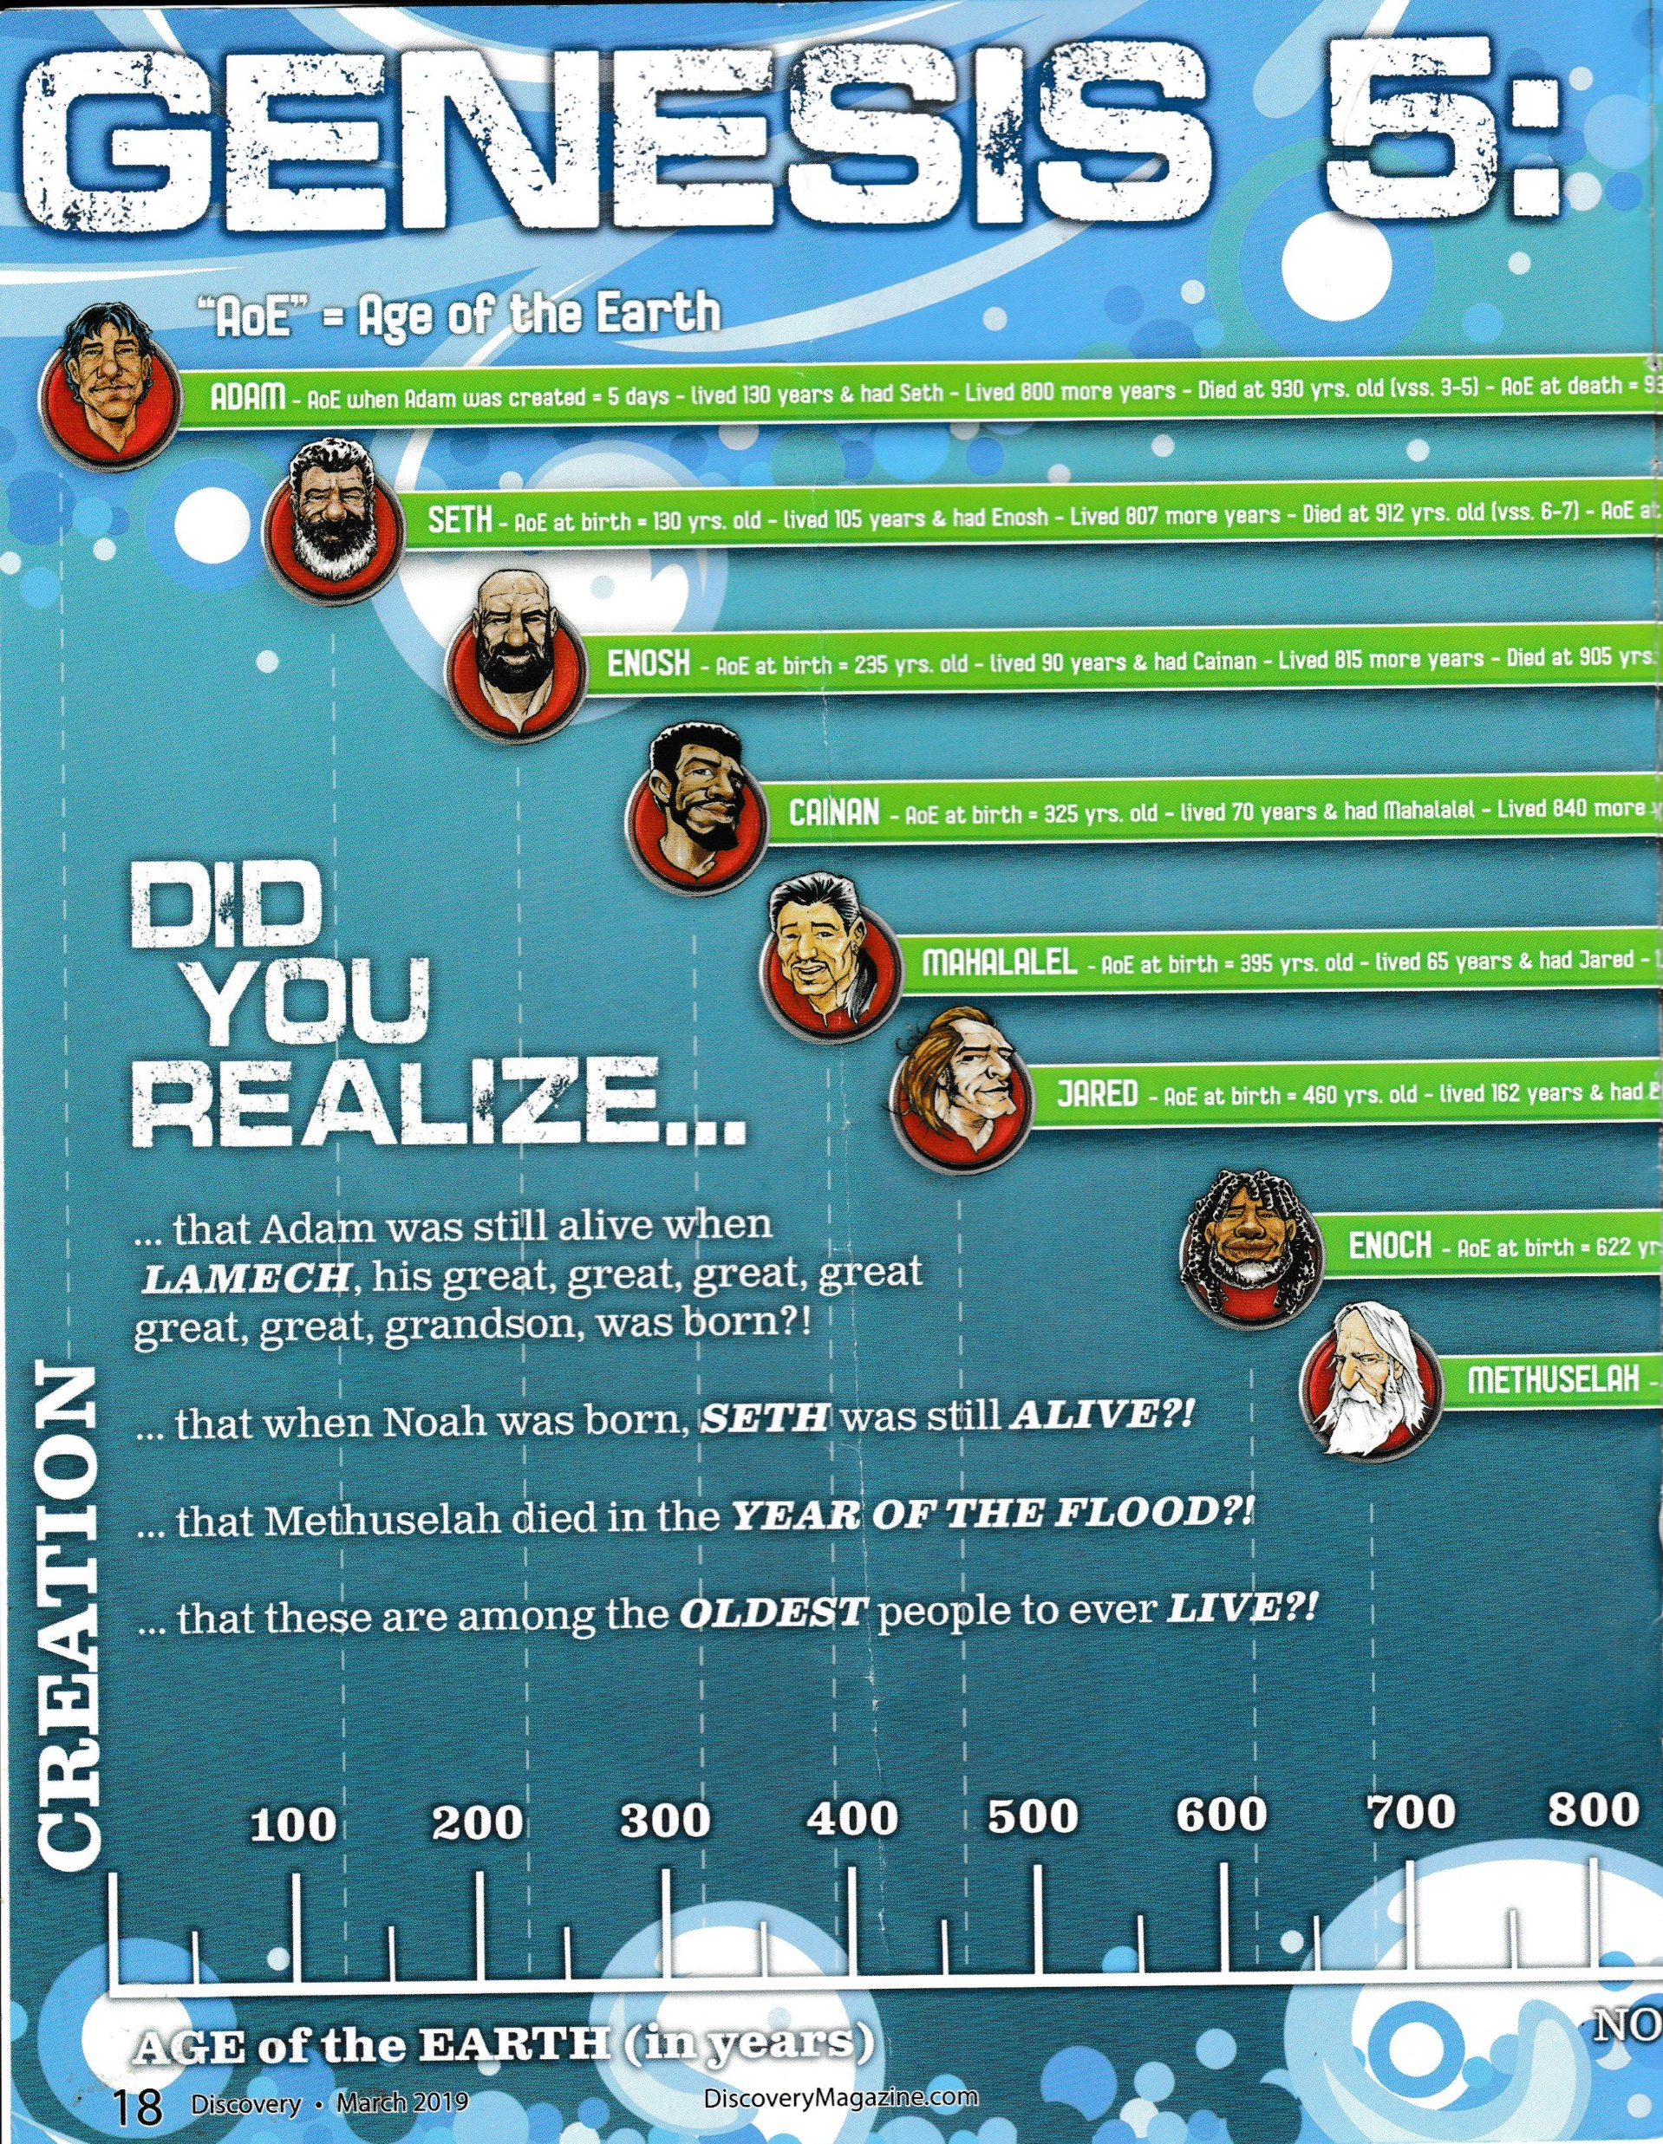
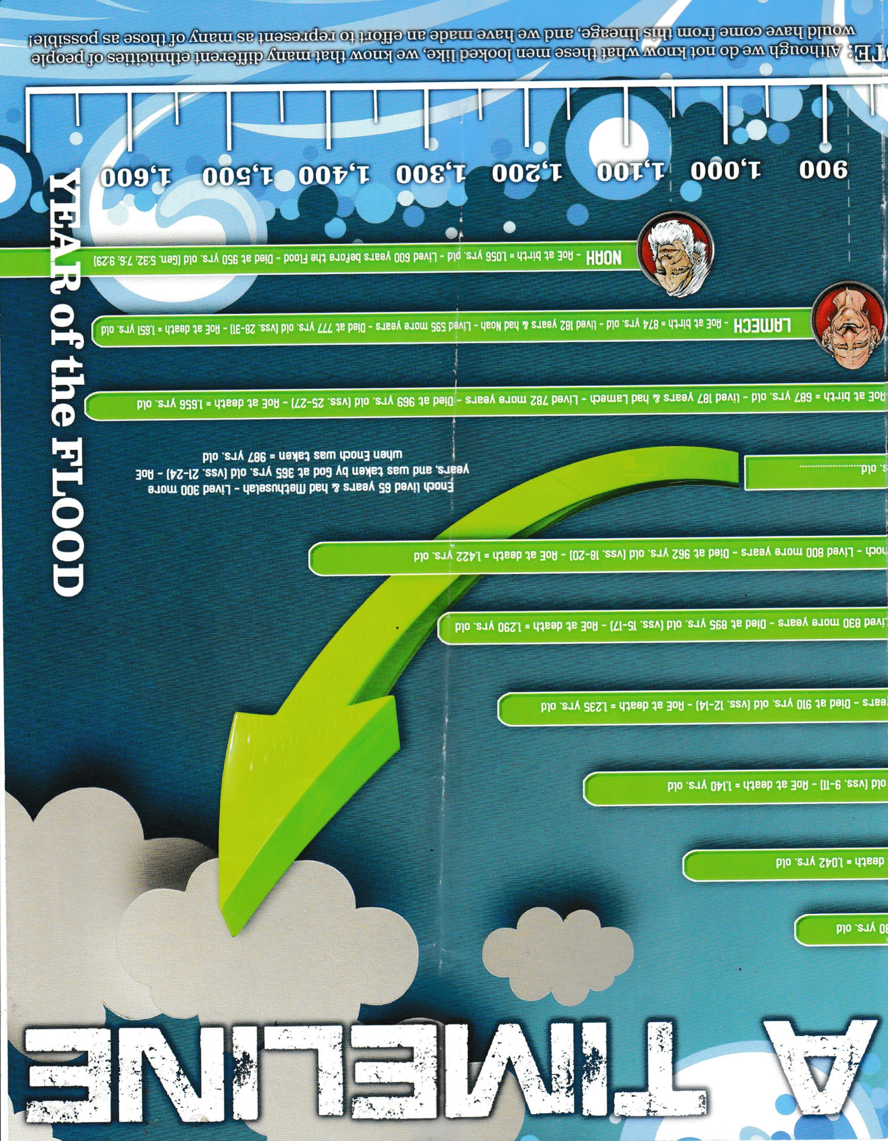
Genealogy – Genesis 5
Gen 5:24 →Enoch was taken by God
Discovery, Apologetics Press, Inc. Vol 30:3, March 2019, p. 18-19.

