Slide 1
Ephesians Part I
30May 2016
Chad Cogburn
Albuquerque, NM

Slide 2
Ephesians - Introduction
Author: Paul
Time: AD 60-62 during Paul’s 1st imprisonment in Rome
Written to the church of Ephesus
Some manuscripts omit “of Ephesus” 1:1; some believe this letter was meant to circulate among the churches of Asia
^{Eph 1:1}Paul, an apostle of Jesus Christ by the will of God, To the saints who are in Ephesus
Ephesus – Modern day Turkey
The commercial center of Asia minor
A religious center; famous for temple of Diana (Artemis in Greek), one of the 7 wonders of the ancient world
Sorcery and demon possession present (Acts 19)
False apostles present (Rev 2)
Paul visited on 2nd mission trip, but stayed 3 years on 3rd mission trip

Slide 3
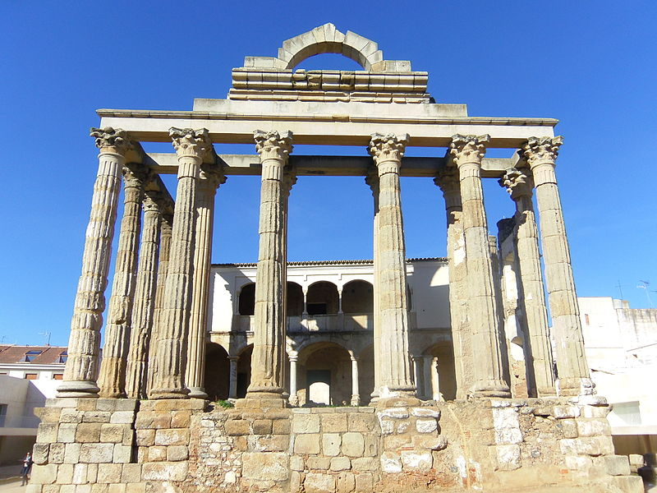
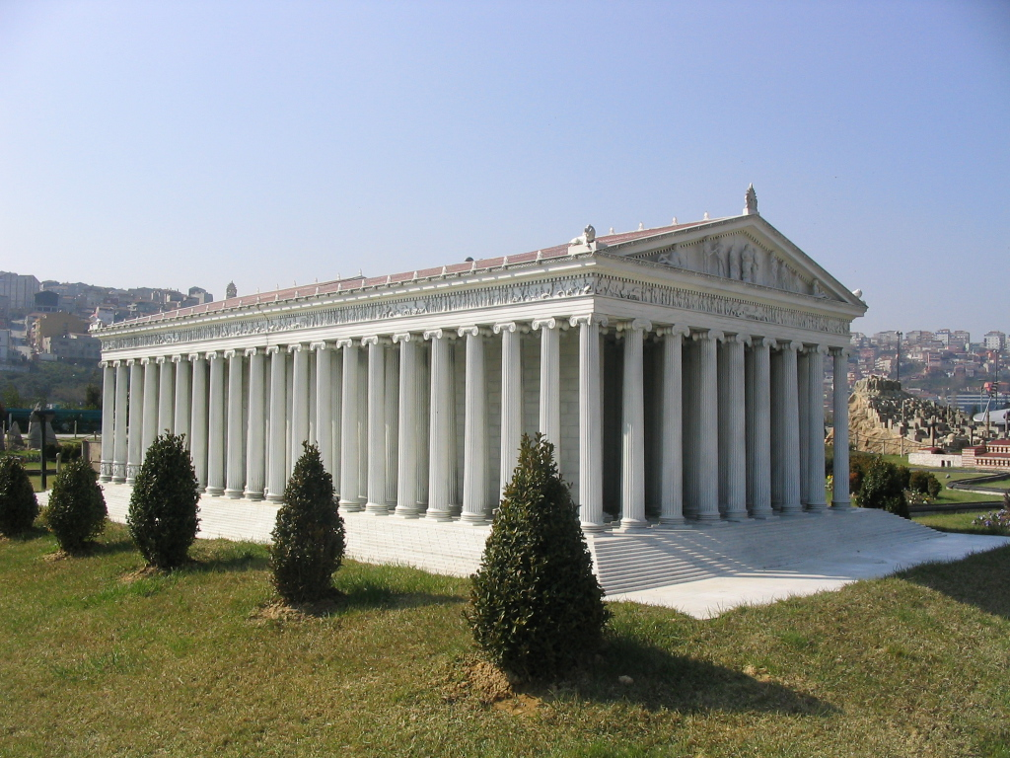
Temple of Diana
Ruins
Probable Appearance

Slide 4
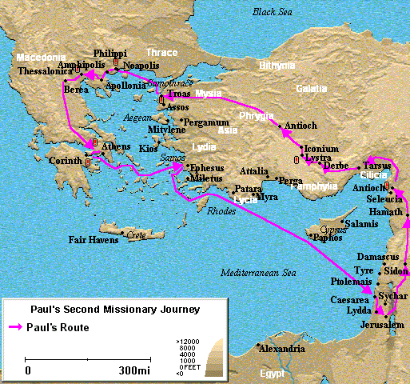

Slide 5
Ephesians - Themes
No specific issues of sin addressed
Sometimes called “Treasure house of the bible”
Terms and Frequency
Fullness and filled – 7
Grace – 12
Glory – 8
Rich and riches – 6
Inheritance – 4
Love – 14
In Christ – 27
Walk – 7
Sin – 1
Ch 1-3 Speak to the resources of the Christian – Riches in Christ
Ch 4-6 Speak to the responsibilities of the Christian

Slide 6
Pivotal Verse
Ephesians 4:1
I, therefore, the prisoner of the Lord, beseech you to walk worthy of the calling with which you were called…
“Therefore”…refers to Ch 1-3
“Walk” introduces Ch 4-6
Because you are rich in Christ (ch 1-3), live a life of Godly purpose (ch 4-6)
Spiritual warfare
Relationships/authority
Redeeming the times
Unity & peace
Rooted and grounded in love

Slide 7
Ephesians 1:1-6
¹Paul, an apostle of Jesus Christ by the will of God, To the saints who are in Ephesus, and faithful in Christ Jesus: ²Grace to you and peace from God our Father and the Lord Jesus Christ.
³Blessed be the God and Father of our Lord Jesus Christ, who has blessed us with every spiritual blessing in the heavenly places in Christ, ⁴just as He chose us in Him before the foundation of the world, that we should be holy and without blame before Him in love, ⁵having predestined us to adoption as sons by Jesus Christ to Himself, according to the good pleasure of His will, ⁶to the praise of the glory of His grace, by which He made us accepted in the Beloved.

Slide 8
Ephesians 1:7-12
⁷In Him we have redemption through His blood, the forgiveness of sins, according to the riches of His grace ⁸which He made to abound toward us in all wisdom and prudence, ⁹having made known to us the mystery of His will, according to His good pleasure which He purposed in Himself, ¹⁰that in the dispensation of the fullness of the times He might gather together in one all things in Christ, both which are in heaven and which are on earth—in Him. ¹¹In Him also we have obtained an inheritance, being predestined according to the purpose of Him who works all things according to the counsel of His will, ¹²that we who first trusted in Christ should be to the praise of His glory.

Slide 9
Predestination IN Christ
Eph 1
⁴just as He chose us in Him before the foundation of the world
⁵having predestined us to adoption as sons by Jesus Christ
¹¹In Him also we have obtained an inheritance, being predestined according to the purpose of Him
“In Christ” is the common thread
Eternal life through Christ was God’s plan from the beginning.

Slide 10
Salvation of the Gentiles
Acts 2:22 “Men of Israel, hear these words: Jesus of Nazareth, a Man attested by God to you by miracles, wonders, and signs which God did through Him in your midst, as you yourselves also know— Him, being delivered by the determined purpose and foreknowledge of God, you have taken by lawless hands, have crucified, and put to death; ²⁴whom God raised up, having loosed the pains of death, because it was not possible that He should be held by it.
God’s pre-determined that Jesus would be crucified
Galatians 3:7 Therefore know that only those who are of faith are sons of Abraham. ⁸And the Scripture, foreseeing that God would justify the Gentiles by faith, preached the gospel to Abraham beforehand, saying, “In you all the nations shall be blessed.” ⁹So then those who are of faith are blessed with believing Abraham.
God planned to save “all the nations” before making the covenant with Abraham

Slide 11
Hidden Wisdom from Old
1 Corinthians 2:6 - 9 However, we speak wisdom among those who are mature, yet not the wisdom of this age, nor of the rulers of this age, who are coming to nothing. ⁷But we speak the wisdom of God in a mystery, the hidden wisdom which God ordained before the ages for our glory, ⁸which none of the rulers of this age knew; for had they known, they would not have crucified the Lord of glory. ⁹But as it is written:
“Eye has not seen, nor ear heard,
Nor have entered into the heart of man
The things which God has prepared for those who love Him.”
¹⁰But God has revealed them to us through His Spirit.
The mystery was pre-ordained
And hidden from sinners and reveal through His Spirit
Vs 9. For those who love Him
What is the mystery?

Slide 12
Predestined to Glory
Romans 8:28 And we know that all things work together for good to those who love God, to those who are the called according to His purpose. ²⁹For whom He foreknew, He also predestined to be conformed to the image of His Son, that He might be the firstborn among many brethren. ³⁰Moreover whom He predestined, these He also called; whom He called, these He also justified; and whom He justified, these He also glorified.
God knows who will respond to the gospel. These are predestined to be called, justified, glorified!

Slide 13
Predestination to Salvation through Christ
1 Thessalonians 5:7 (NASB) For those who sleep do their sleeping at night, and those who get drunk get drunk at night. ⁸But since we are of the day, let us be sober, having put on the breastplate of faith and love, and as a helmet, the hope of salvation. ⁹For God has not destined us for wrath, but for obtaining salvation through our Lord Jesus Christ, ¹⁰who died for us, so that whether we are awake or asleep, we will live together with Him.
Destined for salvation through Christ

Slide 14
God Has Foreknowledge
1 Peter 1:1 Peter, an apostle of Jesus Christ, To the pilgrims of the Dispersion in Pontus, Galatia, Cappadocia, Asia, and Bithynia, ²elect according to the foreknowledge of God the Father, in sanctification of the Spirit, for obedience and sprinkling of the blood of Jesus Christ: Grace to you and peace be multiplied.
God knew beforehand who the elect would be
But each individual still chose to respond to the gospel and obey
Men do not know who will respond

Slide 15
Man’s Choice
Acts 17:26 And He has made from one blood every nation of men to dwell on all the face of the earth, and has determined their pre-appointed times and the boundaries of their dwellings, ²⁷so that they should seek the Lord, in the hope that they might grope for Him and find Him, though He is not far from each one of us; ²⁸for in Him we live and move and have our being, as also some of your own poets have said, ‘For we are also His offspring.’
Pre-appointed times and boundaries so that they seek the Lord
“in the hope” shows their element of free will to accept or reject
Men are created in the image of God with a portion of His Spirit; “free will” may not actually exist
But God allows people to reject Him

Slide 16
Gospel is Open to All
Acts 2:21 And it shall come to pass That whoever calls on the name of the Lord Shall be saved.’
Acts 10:34 Then Peter opened his mouth and said: “In truth I perceive that God shows no partiality. ³⁵But in every nation whoever fears Him and works righteousness is accepted by Him. John 3:16 For God so loved the world that He gave His only begotten Son, that whoever believes in Him should not perish but have everlasting life.
1 Cor 1:21 For since, in the wisdom of God, the world through wisdom did not know God, it pleased God through the foolishness of the message preached to save those who believe.
Salvation is available to whoever responds to the gospel
Salvation is open to all who are open to salvation

Slide 17
Not Willing that any should perish
2 Peter 3:9 The Lord is not slack concerning His promise, as some count slackness, but is longsuffering toward us, not willing that any should perish but that all should come to repentance.
God’s patience is extending opportunity of repentance
God wants everyone to repent

Slide 18
God Grants Repentance
2 Timothy 2:24 And a servant of the Lord must not quarrel but be gentle to all, able to teach, patient, ²⁵in humility correcting those who are in opposition, if God perhaps will grant them repentance, so that they may know the truth, ²⁶and that they may come to their senses and escape the snare of the devil, having been taken captive by him to do his will.
Opportunity for repentance is not guaranteed

Slide 19
Which is it?
Does the bible teach predestination or free will? Yes!
Bible authors state the reality of predestination/foreknowledge and free will/ability to reject God without any hint of contradiction.
God predestined Christ to be the savior of the world
God alone knows beforehand who will respond and who will reject His call
“Whoever calls on the name of the Lord will be saved” Acts 2:21
God is sovereign over man’s destiny

Slide 20
Called, Chosen and Faithful
Revelation 17:14 These will make war with the Lamb, and the Lamb will overcome them, for He is Lord of lords and King of kings; and those who are with Him are called, chosen, and faithful.” Describes those who are “with Christ”
2 Thess 2:13 But we are bound to give thanks to God always for you, brethren beloved by the Lord, because God from the beginning chose you for salvation through sanctification by the Spirit and belief in the truth, ¹⁴to which He called you by our gospel, for the obtaining of the glory of our Lord Jesus Christ. ¹⁵Therefore, brethren, stand fast and hold the traditions which you were taught, whether by word or our epistle.
Called, Chosen, Faithful…This is God’s Way!

Slide 21
Called
Acts 2:38 Then Peter said to them, “Repent, and let every one of you be baptized in the name of Jesus Christ for the remission of sins; and you shall receive the gift of the Holy Spirit. ³⁹For the promise is to you and to your children, and to all who are afar off, as many as the Lord our God will call.”
This promise is extended to “as many as the Lord our God will call”
Is everyone called?
1 Cor 1:2 To the church of God which is at Corinth, to those who are sanctified in Christ Jesus, called to be saints, with all who in every place call on the name of Jesus Christ our Lord, both theirs and ours:
The “called” are those who call on Jesus

Slide 22
God Chooses the Weak
1 Cor 1:26 For you see your calling, brethren, that not many wise according to the flesh, not many mighty, not many noble, are called. ²⁷But God has chosen the foolish things of the world to put to shame the wise, and God has chosen the weak things of the world to put to shame the things which are mighty; ²⁸and the base things of the world and the things which are despised God has chosen, and the things which are not, to bring to nothing the things that are, ²⁹that no flesh should glory in His presence.
James 2:5 Listen, my beloved brethren: Has God not chosen the poor of this world to be rich in faith and heirs of the kingdom which He promised to those who love Him?
Destined for salvation through Christ

Slide 23
Chosen
Vineyard workers (Matt 20) & wedding banquet (Matt 22) both conclude:
Matthew 22:14 “For many are called, but few are chosen.”
Luke 6:13 And when it was day, He called His disciples to Himself; and from them He chose twelve whom He also named apostles:
John 15:16 You did not choose Me, but I chose you and appointed you that you should go and bear fruit, and that your fruit should remain, that whatever you ask the Father in My name He may give you.
Acts 9:15 But the Lord said to him, “Go, for he is a chosen vessel of Mine to bear My name before Gentiles, kings, and the children of Israel. ¹⁶For I will show him how many things he must suffer for My name’s sake.”
Romans 11:4 But what does the divine response say to him? “I have reserved for Myself seven thousand men who have not bowed the knee to Baal.” ⁵Even so then, at this present time there is a remnant according to the election of grace.

Slide 24
Parable of Vineyard Labors
Matthew 20:1 - 16 (NKJV) ¹“For the kingdom of heaven is like a landowner who went out early in the morning to hire laborers for his vineyard. ²Now when he had agreed with the laborers for a denarius a day, he sent them into his vineyard. ³And he went out about the third hour and saw others standing idle in the marketplace, ⁴and said to them, ‘You also go into the vineyard, and whatever is right I will give you.’ So they went. ⁵Again he went out about the sixth and the ninth hour, and did likewise. ⁶And about the eleventh hour he went out and found others standing idle, and said to them, ‘Why have you been standing here idle all day?’ ⁷They said to him, ‘Because no one hired us.’ He said to them, ‘You also go into the vineyard, and whatever is right you will receive.’ ⁸“So when evening had come, the owner of the vineyard said to his steward, ‘Call the laborers and give them their wages, beginning with the last to the first.’ ⁹And when those came who were hired about the eleventh hour, they each received a denarius. ¹⁰But when the first came, they supposed that they would receive more; and they likewise received each a denarius. ¹¹And when they had received it, they complained against the landowner, ¹²saying, ‘These last men have worked only one hour, and you made them equal to us who have borne the burden and the heat of the day.’ ¹³But he answered one of them and said, ‘Friend, I am doing you no wrong. Did you not agree with me for a denarius? ¹⁴Take what is yours and go your way. I wish to give to this last man the same as to you. ¹⁵Is it not lawful for me to do what I wish with my own things? Or is your eye evil because I am good?’ ¹⁶So the last will be first, and the first last. For many are called, but few chosen.”

Slide 25
Parable of Wedding Guests
Matthew 22:1 - 14 (NKJV) ¹And Jesus answered and spoke to them again by parables and said: ²“The kingdom of heaven is like a certain king who arranged a marriage for his son, ³and sent out his servants to call those who were invited to the wedding; and they were not willing to come. ⁴Again, he sent out other servants, saying, ‘Tell those who are invited, “See, I have prepared my dinner; my oxen and fatted cattle are killed, and all things are ready. Come to the wedding.”’ ⁵But they made light of it and went their ways, one to his own farm, another to his business. ⁶And the rest seized his servants, treated them spitefully, and killed them. ⁷But when the king heard about it, he was furious. And he sent out his armies, destroyed those murderers, and burned up their city. ⁸Then he said to his servants, ‘The wedding is ready, but those who were invited were not worthy. ⁹Therefore go into the highways, and as many as you find, invite to the wedding.’ ¹⁰So those servants went out into the highways and gathered together all whom they found, both bad and good. And the wedding hall was filled with guests.
¹¹“But when the king came in to see the guests, he saw a man there who did not have on a wedding garment. ¹²So he said to him, ‘Friend, how did you come in here without a wedding garment?’ And he was speechless. ¹³Then the king said to the servants, ‘Bind him hand and foot, take him away, and cast him into outer darkness; there will be weeping and gnashing of teeth.’ ¹⁴“For many are called, but few are chosen.”

Slide 26
God’s Purpose Fulfilled in People
Romans 9:10 And not only this, but when Rebecca also had conceived by one man, even by our father Isaac ¹¹(for the children not yet being born, nor having done any good or evil, that the purpose of God according to election might stand, not of works but of Him who calls), ¹²it was said to her, “The older shall serve the younger.” ¹³As it is written, “Jacob I have loved, but Esau I have hated.”
¹⁴What shall we say then? Is there unrighteousness with God? Certainly not! ¹⁵For He says to Moses, “I will have mercy on whomever I will have mercy, and I will have compassion on whomever I will have compassion.”
God reserves the right to call men for specific purposes according to His will
Does this make God unrighteous? Vs 14 No
¹⁸Therefore He has mercy on whom He wills, and whom He wills He hardens.
This is difficult for humans to accept, but God is sovereign over all.

Slide 27
Discriminate Preaching?
Paul preached the gospel, even to those who rejected his message (e.g. Acts 17)
Parable of sower (Matt 13); seed was sown on all types of soil
Whoever will not receive your words…shake the dust from your feet (Matt 10:14)
Jesus gave attention to even the most unlikely converts (tax collectors, Samaritan woman, etc.)
Man does not know who will accept or reject the gospel.

Slide 28
Ephesians 1:3 Key Verse
¹Paul, an apostle of Jesus Christ by the will of God, To the saints who are in Ephesus, and faithful in Christ Jesus: ²Grace to you and peace from God our Father and the Lord Jesus Christ.
³Blessed be the God and Father of our Lord Jesus Christ, who has blessed us with every spiritual blessing in the heavenly places in Christ, ⁴just as He chose us in Him before the foundation of the world, that we should be holy and without blame before Him in love, ⁵having predestined us to adoption as sons by Jesus Christ to Himself, according to the good pleasure of His will, ⁶to the praise of the glory of His grace, by which He made us accepted in the Beloved.
Riches of God’s spiritual blessings is the main topic

Slide 29
Conclusion
Paul is reminding the Ephesians (and everyone else) that Christians have been showered with every spiritual blessing. We are truly rich in God through Jesus Christ.
God predestines all faithful Christians to inherit eternal life (apostasy is real though).
God has foreknowledge of who the elect will be…But He does not reveal this to man.
God predestines some people by His perfect will for specific purposes (Esau/Jacob).
Hard to understand, but God is sovereign and does not make mistakes in his word.
“Let God be true but every man a liar” Rom 3:4
Assume everyone needs to hear the gospel.

