Slide 1
Fear of GoD Part III
Chad Cogburn
28 February 2016
Albuquerque, NM

Slide 2
Fear of God Outline
Part I
What is the Fear of God?
Why Fear God?
Part II
Love vs. Fear
Ungodly Fear
Part III
Daily Fearing God (practical application)

Slide 3
Part I Recap - The Fear of God is…
Psalms 19:9 The fear of the Lord is clean (lit. pure), enduring forever; The judgments of the Lord are true and righteous altogether. Psalms 111:10 The fear of the Lord is the beginning of wisdom; A good under-standing have all those who do His commandments. His praise endures forever.
Proverbs 1:7 The fear of the Lord is the beginning of knowledge, But fools despise wisdom and instruction. Proverbs 8:13 The fear of the Lord is to hate evil; Pride and arrogance and the evil way And the perverse mouth I hate. Proverbs 9:10 “The fear of the Lord is the beginning of wisdom, And the knowledge of the Holy One is understanding. Proverbs 14:26 In the fear of the Lord there is strong confidence, And His children will have a place of refuge. Proverbs 14:27 The fear of the Lord is a fountain of life, To turn one away from the snares of death. Proverbs 15:33 The fear of the Lord is the instruction of wisdom, And before honor is humility. Psalms 25:12 Who is the man that fears the Lord? Him shall He teach in the way He chooses.
Proverbs 10:27 The fear of the Lord prolongs days, But the years of the wicked will be shortened.

Slide 4
Part II Recap - Purpose of Godly Fear
Terror
Spectrum of Godly fear
Reverence
Severity
Spectrum of God’s outpouring
Goodness
Rom 11:22
Fear of Torment
Motive for obedience
“Perfect” Love
1 John 4:18, 1 Tim 1:9
Ungodly
Righteous
REPENTANCE
Rom 2:4 Or do you despise the riches of His goodness, forbearance, and longsuffering, not knowing that the goodness of God leads you to repentance?
2 Cor 7:10 For godly sorrow produces repentance leading to salvation, not to be regretted; but the sorrow of the world produces death.

Slide 5
Part III - Introduction
Ecclesiastes 12:13
Let us hear the conclusion of the whole matter: Fear God, and keep his commandments: for this is the whole duty of man.

Slide 6
Give Place to Wrath
Romans 12:17 Repay no one evil for evil. Have regard for good things in the sight of all men. ¹⁸If it is possible, as much as depends on you, live peaceably with all men. ¹⁹Beloved, do not avenge yourselves, but rather give place to wrath; for it is written, “Vengeance is Mine, I will repay,” says the Lord.
God fearing people give the place of wrath to God and do not take revenge
Don’t stand in God’s place – Let God be God
God fearing people live peaceable if possible
Examples
Road rage
Business deals gone bad
Being slandered

Slide 7
Lack of Knowledge
Romans 10:1 Brethren, my heart’s desire and prayer to God for Israel is that they may be saved. ²For I bear them witness that they have a zeal for God, but not according to knowledge. ³For they being ignorant of God’s righteousness, and seeking to establish their own righteousness, have not submitted to the righteousness of God.
How many “Christians” are ignorant of God’s righteousness?
Hebrews 5:12 For though by this time you ought to be teachers, you need someone to teach you again the first principles of the oracles of God; and you have come to need milk and not solid food. ¹³For everyone who partakes only of milk is unskilled in the word of righteousness, for he is a babe.
There is no excuse for biblical ignorance
God expects ALL Christians to be knowledgeable of His word enough to teach it

Slide 8
Abundant Knowledge
We live in a time of abundant knowledge. It’s not without problems.
1 Cor 8:1 Now concerning things offered to idols: We know that we all have knowledge. Knowledge puffs up, but love edifies. 2And if anyone thinks that he knows anything, he knows nothing yet as he ought to know.
Knowledge becomes an idol for some
Source of great pride; it “puffs up”
Knows nothing as he “ought” – useful vs. vain knowledge
1 Cor 8:11 And because of your knowledge shall the weak brother perish, for whom Christ died? 12But when you thus sin against the brethren, and wound their weak conscience, you sin against Christ.
Knowledge can be used to destroy a weak brother
There’s been a lot of destruction in the church due to “knowledge”

Slide 9
May our Knowledge Fear the Lord
Proverbs 1:7 The fear of the Lord is the beginning of knowledge, But fools despise wisdom and instruction.
Lack of knowledge
Knowledge in the Fear of God
Abundant knowledge
Ignorant of God’s righteousness
Unskilled in the word
Hosea 4:6 My people are destroyed for lack of knowledge.
“God’s” Knowledge
Humility (next slide)
Builds up & edifies
Seeks truth
Colossians 1:10 …increasing in the knowledge of God
Human intelligence Pride/Puffs Up
Destroys the church
Seeks self
2 Timothy 3:7 always learning and never able to come to the knowledge of the truth.

Slide 10
Knowledge - Speaking as God’s Oracles
1 Peter 4:10 As each one has received a gift, minister it to one another, as good stewards of the manifold grace of God. ¹¹If anyone speaks, let him speak as the oracles of God. If anyone ministers, let him do it as with the ability which God supplies, that in all things God may be glorified through Jesus Christ, to whom belong the glory and the dominion forever and ever. Amen.
We speak the words given to us by God; they are not our own
Godly knowledge works the same way. It is given by God.
What’s there to brag about?
Purpose: That God be glorified

Slide 11
Diffusing His Knowledge in Every Place
2 Cor 2:14 Now thanks be to God who always leads us in triumph in Christ, and through us diffuses the fragrance of His knowledge in every place. ¹⁵For we are to God the fragrance of Christ among those who are being saved and among those who are perishing.
Examples of God’s knowledge
Scriptures – inerrant word of God
All creation declares the glory of God
Design of human body systems
Balancing force of our geo & eco systems
Earth’s conditions perfectly suited for life
“He made the stars also” Gen 1:16b
Our conduct speaks louder than our preaching
2 Corinthians 5:20 Now then, we are ambassadors for Christ…

Slide 12
May our Churches Fear God
Acts 9:31 Then the churches throughout all Judea, Galilee, and Samaria had peace and were edified. And walking in the fear of the Lord and in the comfort of the Holy Spirit, they were multiplied.
Early church figuring out the application to the instructions
They did so by “walking in the fear of the Lord”
Ephesians 5:18 And do not be drunk with wine, in which is dissipation; but be filled with the Spirit, ¹⁹speaking to one another in psalms and hymns and spiritual songs, singing and making melody in your heart to the Lord, ²⁰giving thanks always for all things to God the Father in the name of our Lord Jesus Christ, ²¹submitting to one another in the fear of God.
Submissive attitudes key to church unity and peace

Slide 13
May our Churches Fear God
James 4:11 Do not speak evil of one another, brethren. He who speaks evil of a brother and judges his brother, speaks evil of the law and judges the law…

Slide 14
Application - Authority
Authority created at the beginning – God→Man→Creation
Romans 13:1 Let every soul be subject to the governing authorities. For there is no authority except from God, and the authorities that exist are appointed by God.
Authority is from God, not man
We don’t “own” authority, it is entrusted by God
Abuse of power
Pharaoh made Israel slaves – Ex 5
Rehoboam increased oppression – 1 Kings 12
David had Uriah killed – 2 Sam 11
Proverbs 29:2 When the righteous are in authority, the people rejoice; But when a wicked man rules, the people groan.
Be faithful with your authority! Don’t abuse it.

Slide 15
Example - Nehemiah
Nehemiah 5:15 But the former governors who were before me laid burdens on the people, and took from them bread and wine, besides forty shekels of silver. Yes, even their servants bore rule over the people, but I did not do so, because of the fear of God.
Nehemiah governed the city under the fear of God!
He refused to oppress the people with unfair taxation
7:1 Then it was, when the wall was built and I had hung the doors, when the gatekeepers, the singers, and the Levites had been appointed, ²that I gave the charge of Jerusalem to my brother Hanani, and Hananiah the leader of the citadel, for he was a faithful man and feared God more than many.
God fearing men pass the torch to God fearing men

Slide 16
Our Responsibility to Authorities
Romans 13:2 Therefore whoever resists the authority resists the ordinance of God, and those who resist will bring judgment on themselves.
Acts 23:5 Then Paul said, “I did not know, brethren, that he was the high priest; for it is written, ‘You shall not speak evil of a ruler of your people.’”
1 Timothy 2:1 Therefore I exhort first of all that supplications, prayers, intercessions, and giving of thanks be made for all men, ²for kings and all who are in authority, that we may lead a quiet and peaceable life in all godliness and reverence. ³For this is good and acceptable in the sight of God our Savior
God commands us to obey and pray for our authorities, no matter how good or evil they are
God fearing people will not speak evil of authorities

Slide 17
Do not Speak Evil of Authorities
2 Peter 2:10 and especially those who walk according to the flesh in the lust of uncleanness and despise authority. They are presumptuous, self-willed. They are not afraid to speak evil of dignitaries, ¹¹whereas angels, who are greater in power and might, do not bring a reviling accusation against them before the Lord.
We ought to be AFRAID to speak evil of authority
Jude 1:8 Likewise also these dreamers defile the flesh, reject authority, and speak evil of dignitaries. ⁹Yet Michael the archangel, in contending with the devil, when he disputed about the body of Moses, dared not bring against him a reviling accusation, but said, “The Lord rebuke you!”
Michael would not even speak evil of Satan!
But rather, gave place to God’s rebuke; He knew his place!

Slide 18
Honor our Elders
Leviticus 19:32 ‘You shall rise before the gray headed and honor the presence of an old man, and fear your God: I am the Lord.

Slide 19
May our Homes Fear the Lord
Deuteronomy 6:1 “Now this is the commandment, and these are the statutes and judgments which the Lord your God has commanded to teach you, that you may observe them in the land which you are crossing over to possess, ²that you may fear the Lord your God, to keep all His statutes and His commandments which I command you, you and your son and your grandson, all the days of your life, and that your days may be prolonged. ³Therefore hear, O Israel, and be careful to observe it, that it may be well with you, and that you may multiply greatly as the Lord God of your fathers has promised you—‘a land flowing with milk and honey.’ ⁴“Hear, O Israel: The Lord our God, the Lord is one! ⁵You shall love the Lord your God with all your heart, with all your soul, and with all your strength. ⁶“And these words which I command you today shall be in your heart. ⁷You shall teach them diligently to your children, and shall talk of them when you sit in your house, when

Slide 20
May our Homes Fear the Lord
you walk by the way, when you lie down, and when you rise up. ⁸You shall bind them as a sign on your hand, and they shall be as frontlets between your eyes. ⁹You shall write them on the doorposts of your house and on your gates.
Generational faithfulness commanded
Our children must learn to fear God from a young age
God’s commandments were rehearsed all the time
Keep the altar fires burning at home
Ephesians 6:1 Children, obey your parents in the Lord, for this is right. ²“Honor your father and mother,” which is the first commandment with promise: ³“that it may be well with you and you may live long on the earth.”
Children learn how to honor God by first honoring their parents
The promise is both present (parents) and future (walk with God)

Slide 21
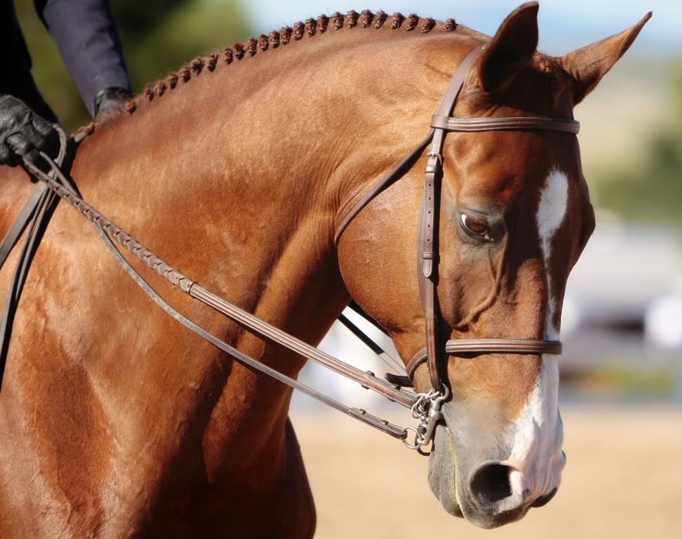
May our Tongues Fear the Lord
James 1:26 If anyone among you thinks he is religious, and does not bridle his tongue but deceives his own heart, this one’s religion is useless.
“Bridle”: to lead by restraint
Bridle used to lead 1500lb animal
Examples
God’s name
Vain words
Lying
Gossip/Slander
Matthew 12:36 But I say to you that for every idle word men may speak, they will give account of it in the day of judgment. ³⁷For by your words you will be justified, and by your words you will be condemned.”

Slide 22
May our Fear the Lord
Matthew 6:22 “The lamp of the body is the eye… Job was a man who feared God
Job 1:1 There was a man in the land of Uz, whose name was Job; and that man was blameless and upright, and one who feared God and shunned evil. One of Job’s defenses was his purity from lust Job 31:1 “I have made a covenant with my eyes; Why then should I look upon a young woman?
Proverbs 4:25 Let your eyes look straight ahead, And your eyelids look right before you. ²⁶Ponder the path of your feet, And let all your ways be established. ²⁷Do not turn to the right or the left; Remove your foot from evil.
Wandering eyes symptom of a weak spirit

Slide 23
May our Wives Fear the Lord
1 Peter 3:1 Wives, likewise, be submissive to your own husbands, that even if some do not obey the word, they, without a word, may be won by the conduct of their wives, ²when they observe your chaste conduct accompanied by fear. ³Do not let your adornment be merely outward—arranging the hair, wearing gold, or putting on fine apparel— ⁴rather let it be the hidden person of the heart, with the incorruptible beauty of a gentle and quiet spirit, which is very precious in the sight of God.
Conduct advertises Conviction
Conduct with fear of God is powerful enough to…WIN people!
Be adorned with the fear of God, not to draw men’s eyes

Slide 24
May our Husbands Fear the Lord
1 Peter 3:7 Husbands, likewise, dwell with them with understanding, giving honor to the wife, as to the weaker vessel, and as being heirs together of the grace of life, that your prayers may not be hindered.
Husbands who fear God will dwell with understanding!
Lifeline to God is at stake!!
Husband
Love Eph 5
Honor 1 Pet 3
Be understanding 1 Pet 3
Render affection 1 Cor 7
Wash w/word Eph 5
Wife
Submit 1 Pet 3
Respect Eph 5
Obey Titus 2
Love Titus 2
Render affection 1 Cor 7

Slide 25
May our Marriages Fear the Lord
Ephesians 5:18 And do not be drunk with wine, in which is dissipation; but be filled with the Spirit, ¹⁹speaking to one another in psalms and hymns and spiritual songs, singing and making melody in your heart to the Lord, ²⁰giving thanks always for all things to God the Father in the name of our Lord Jesus Christ, ²¹submitting to one another in the fear of God.
One sided marriages are not being conducted in the fear of God!
Godly conflict resolution of all types requires humility

Slide 26
May our Prayers Fear God
Hebrews 5:5 So also Christ did not glorify Himself to become High Priest, but it was He who said to Him:
“You are My Son, Today I have begotten You.” ⁶As He also says in another place: “You are a priest forever According to the order of Melchizedek”;
⁷who, in the days of His flesh, when He had offered up prayers and supplications, with vehement cries and tears to Him who was able to save Him from death, and was heard because of His godly fear, ⁸though He was a Son, yet He learned obedience by the things which He suffered. ⁹And having been perfected, He became the author of eternal salvation to all who obey Him,…
Even Jesus had godly fear!
God listens to the prayers to those who fear Him

Slide 27
Examples Who Didn’t Fear God
Lucifer - Isa 14:13 “I will exalt my throne above the stars of God”
Eli’s sons - 1 Sam 2 Despised sacrifices of God/fornication
Korah - Num 16 Rejected Moses’ place
Aaron and Miriam – Num 12:8 “Why then were you not afraid To speak against My servant Moses?”
The 10 spies and Israel – Num 13-14 Grasshopper complex
Achan – Josh 7 took prohibited spoils at Jericho
Uzza – 1 Chron 13 put out his hand to hold the ark,
Judas – Luke 22 betrayed Jesus
Almost every example of conflict is because man got out of place

Slide 28
Summary
Hebrews 12:28 Therefore, since we are receiving a kingdom which cannot be shaken, let us have grace, by which we may serve God acceptably with reverence and godly fear. ²⁹For our God is a consuming fire.

