Slide 1
Truth Study
Chad Cogburn
Summary
Psalms 119:160
The entirety of Your word is truth, And every one of Your righteous judgments endures forever.

Slide 2
Serial Study Outline
Knowing the Truth: “You shall know the truth” John 8:32a
Loving the Truth: “The Truth shall make you free” John 8:32b
Living the Truth: “Walk in Truth” 3 John 1:3-4
Integrity
Secular vs. Spiritual
Trusting the Truth: “The truth of the Lord endures forever” Psalms 117:2
The amazing journey of God’s word
The amazing journey of God’s people

Slide 3
Truth Part III.
Living the Truth
Chad Cogburn
7 Dec 2014

Slide 4
Living the Truth
Know Truth (God is the source of all truth)
Love Truth (Embrace both the good and bad)
Live Truth; this is the hard part
Act on the truth, whatever it is
Ignoring problems compounds them
Proverbs 11:3 The integrity of the upright will guide them, But the perversity of the unfaithful will destroy them.
Proverbs 10:9 He who walks with integrity walks securely, But he who perverts his ways will become known.
Integrity: complete, full, whole
Perversity: distort
Denying truth leads to destructive behavior/lifestyle

Slide 5
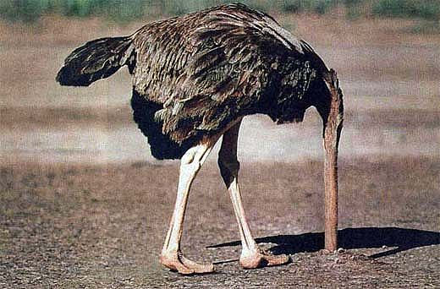
Ignore it and it will go away….
This is what we do with some important issues in life

Slide 6
Escapism – Unplugging from Life
Excessive immersion in alternative worlds to escape reality
“I don’t have to be me until Monday” - Country song
Comes in many forms (all often addictions)
Drugs/alcohol
Sports
Entertainment (games, virtual reality, TV, movies, etc.)
Work
Celebrity worship
Sexual immorality
Consumerism - "Our natural tendency is to resist difficult emotions, so we medicate them. To do that, some choose alcohol, some choose eating and some choose overspending." – Financial Advisor Richard Kahler
Prov 18:1 A man who isolates himself seeks his own desire; He rages against all wise judgment.
Running from issues does not help anyone

Slide 7
Kill Sin Early! Don’t Ignore it!
Deuteronomy 13:6 “If your brother, the son of your mother, your son or your daughter, the wife of your bosom, or your friend who is as your own soul, secretly entices you, saying, ‘Let us go and serve other gods,’… ⁸you shall not consent to him or listen to him, nor shall your eye pity him, nor shall you spare him or conceal him; ⁹but you shall surely kill him;…
God dealt with idolatry as soon as it was suggested
Sin will spread quickly if not dealt with early
Love the truth when our conscience warns us of possible sin
Flee sin (1Cor 6:18, 10:14, 1Tim 6:11, 2Tim 2:22)
Gen 39:12 she caught him by his garment, saying, “Lie with me.” But he left his garment in her hand, and fled and ran outside. – Joseph didn’t hesitate – He Loved the Truth! James 1:14-15 Desires entice, gives birth to sin, brings death

Slide 8
Secular vs. Sacred
Are these separate realities that we live in?
Scriptures makes a distinction between these
Physical vs. spiritual
Common vs. Holy
Not disconnected
God has set apart a people to himself, not activities.
2 Peter 3:11 Therefore, since all these things will be dissolved, what manner of persons ought you to be in holy conduct and godliness, ¹²looking for and hastening the coming of the day of God…

Slide 9
Divinely Inspired People?
2 Peter 1:3 as His divine power has given to us all things that pertain to life and godliness, through the knowledge of Him who called us by glory and virtue, 4by which have been given to us exceedingly great and precious promises, that through these you may be partakers of the divine nature, having escaped the corruption that is in the world through lust.
God gave standards and principles by which to live life and live a godly life.
Partaker: partner, sharer
God shares his divineness with us!
Indwelling Holy Spirit
Holiness isn’t something we do, it is something we are
God’s Holiness teaches us how to conduct our lives

Slide 10
Living the Truth
1 Peter 1:13 Therefore gird up the loins of your mind, be sober, and rest your hope fully upon the grace that is to be brought to you at the revelation of Jesus Christ; ¹⁴as obedient children, not conforming yourselves to the former lusts, as in your ignorance; ¹⁵but as He who called you is holy, you also be holy in all your conduct,¹⁶because it is written, “Be holy, for I am holy.”
A sober mind – not disillusioned or running from truth
“BE Holy”
He didn’t say to act, speak, think, eat, dress, drive, work, study, read, parent, manage…Holy
He didn’t say stay out of bars, off the wrong websites, watch bad movies,… He doesn’t have to.
Don’t act holy, Be Holy…Set apart for God.
God doesn’t set apart times & places to himself.
He sets apart PEOPLE to himself.

Slide 11
Secular vs. Sacred Knowledge
Proverbs 1:7 The fear of the LORD is the beginning of knowledge, But fools despise wisdom and instruction.
Knowledge and abilities come from God (Col 2:3, Prov 2, Ex 31:1-5, Dan 1:17, Deut 8:18,…)
All pursuits of knowledge must be done with the Fear of God
Why do I need/want this knowledge? Motive check.
Textbooks (or any source of knowledge) don’t have to be read with the same worldview of the author.
A&P declares God’s marvelous design
Engineering statics/dynamics declares God’s perfect laws
Calculus declares God’s order of the universe
Composition declares God’s creation of communications
History confirms God’s intervention and sovereignty
No realm of knowledge (or life) is exempt from God’s sovereignty.

Slide 12
2 Views That Affect Behavior
Reality
Distorted View
Spiritual
Angels & demons
God & Satan
Physical
Physical
(Body)
Soul & Spirit
Heaven & Hell
Human decisions based on moral, eternal, invisible and visible
Value life
Self control
Treasures in heaven
Human decisions based on “reason”, temporal, visible
(Humanism)
Abortion, infanticide, genocide
Promiscuity, immorality
Treasures on earth
2 Cor 5:7 For we walk by faith, not by sight.

Slide 13
Connections
From birth to death, we make connections
Living the Truth is essentially about making the connection between Truth and Life
Actions
Col 3:17
Beliefs
Phil 3:15
TRUTH
John 8:31-32
Abiding in Christ
Expectations
Rom 15:18-20
Attitudes
Phil 2:5
Words
Titus 2:8
Thoughts 2Cor 10:5
Disconnections = double-minded (James 1:8, 4:8)

Slide 14
Does God Care About…?
Question: Marriage? Y Vanilla or chocolate ice cream? N
Matthew 10:29 Are not two sparrows sold for a copper coin? And not one of them falls to the ground apart from your Father’s will. ³⁰But the very hairs of your head are all numbered.
Are we asking the right questions? Do we pick the questions that will justify our desires?
At some level, every question is subject to God’s principles
Chocolate vs Vanilla
Desert/sweets
Food
Health
Stewardship the body
Temple of the Holy Spirit (1 Cor 3:16-19, 1 Cor 6:19)
1 Cor 10:31 Therefore, whether you eat or drink, or whatever you do, do all to the glory of God.
Covers just about everything

Slide 15
Spiritual Warfare
Ephesians 6:11 Put on the whole armor of God, that you may be able to stand against the wiles of the devil. ¹²For we do not wrestle against flesh and blood, but against principalities, against powers, against the rulers of the darkness of this age, against spiritual hosts of wickedness in the heavenly places. ¹³Therefore take up the whole armor of God, that you may be able to withstand in the evil day, and having done all, to stand.
Spiritual warfare takes places while we are still in the body
Spiritual powers are manifested in the physical realm
We do not fight Satan in hand to hand combat, but Satan’s schemes are manifested in the physical
1 John 2:16 For all that is in the world—the lust of the flesh, the lust of the eyes, and the pride of life—is not of the Father but is of the world.

Slide 16
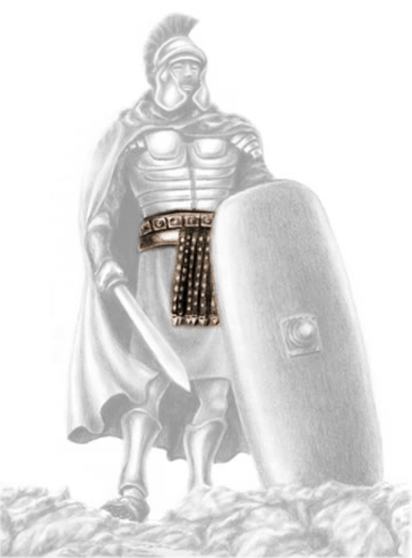
Spiritual Warfare Depends on Truth
Ephesians 6:14 Stand therefore, having girded your waist with truth, having put on the breastplate of righteousness, ¹⁵and having shod your feet with the preparation of the gospel of peace; ¹⁶above all, taking the shield of faith with which you will be able to quench all the fiery darts of the wicked one. ¹⁷And take the helmet of salvation, and the sword of the Spirit, which is the word of God; ¹⁸praying always with all prayer and supplication in the Spirit, being watchful to this end with all perseverance and supplication for all the saints
Belt holds the sheath and other garments secure
Without the belt, the armor is loose
Truth is the anchor

Slide 17
Conclusion
James 1:1 James, a bondservant of God and of the Lord Jesus Christ, To the twelve tribes which are scattered abroad: Greetings. ²My brethren, count it all joy when you fall into various trials, ³knowing that the testing of your faith produces patience. ⁴But let patience have its perfect work, that you may be perfect and complete, lacking nothing. ⁵If any of you lacks wisdom, let him ask of God, who gives to all liberally and without reproach, and it will be given to him. ⁶But let him ask in faith, with no doubting, for he who doubts is like a wave of the sea driven and tossed by the wind. ⁷For let not that man suppose that he will receive anything from the Lord; ⁸he is a double-minded man, unstable in all his ways. ⁹Let the lowly brother glory in his exaltation, ¹⁰but the rich in his humiliation, because as a flower of the field he will pass away. ¹¹For no sooner has the sun risen with a burning heat than it withers the grass; its flower falls, and its beautiful appearance perishes. So the rich man also

Slide 18
will fade away in his pursuits. ¹²Blessed is the man who endures temptation; for when he has been approved, he will receive the crown of life which the Lord has promised to those who love Him. ¹³Let no one say when he is tempted, “I am tempted by God”; for God cannot be tempted by evil, nor does He Himself tempt anyone. ¹⁴But each one is tempted when he is drawn away by his own desires and enticed. ¹⁵Then, when desire has conceived, it gives birth to sin; and sin, when it is full-grown, brings forth death. ¹⁶Do not be deceived, my beloved brethren. ¹⁷Every good gift and every perfect gift is from above, and comes down from the Father of lights, with whom there is no variation or shadow of turning. ¹⁸Of His own will He brought us forth by the word of truth, that we might be a kind of firstfruits of His creatures. ¹⁹So then, my beloved brethren, let every man be swift to hear, slow to speak, slow to wrath; ²⁰for the wrath of man does not produce the righteousness of God. ²¹Therefore lay aside all filthiness and overflow of wickedness, and receive with meekness the implanted word, which is able to save your souls.

Slide 19
²²But be doers of the word, and not hearers only, deceiving yourselves. ²³For if anyone is a hearer of the word and not a doer, he is like a man observing his natural face in a mirror; ²⁴for he observes himself, goes away, and immediately forgets what kind of man he was. ²⁵But he who looks into the perfect law of liberty and continues in it, and is not a forgetful hearer but a doer of the work, this one will be blessed in what he does. ²⁶If anyone among you thinks he is religious, and does not bridle his tongue but deceives his own heart, this one’s religion is useless. ²⁷Pure and undefiled religion before God and the Father is this: to visit orphans and widows in their trouble, and to keep oneself unspotted from the world.

Slide 20
Backup charts

Slide 21
Love, Obedience & Truth
1 John 2:3 Now by this we know that we know Him, if we keep His commandments. ⁴He who says, “I know Him,” and does not keep His commandments, is a liar, and the truth is not in him. ⁵But whoever keeps His word, truly the love of God is perfected in him. By this we know that we are in Him. ⁶He who says he abides in Him ought himself also to walk just as He walked.
Obedience → Love of God → Love of Truth
“People can’t change the truth, but truth can change people” – author unknown

Slide 22
Do we love the Truth?
Does the love of biblical truths move us to action?
Holiness
Honesty
“If you tell the truth, you don’t have to remember anything.”
Honor one another
Love one another
Wholesome talk
Unselfishness
Kindness
Encourage
Put talents to work
Boldly proclaim Jesus
Seek first the kingdom

Slide 23
Different Types of Knowledge?
Are there different types of knowledge? (sacred vs. secular)
Col 2:2…and attaining to all riches of the full assurance of understanding, to the knowledge of the mystery of God, both of the Father and of Christ, ³in whom are hidden all the treasures of wisdom and knowledge.
Prov 2:1 My son, if you receive my words, And treasure my commands within you, ²So that you incline your ear to wisdom, And apply your heart to understanding; ³ Yes, if you cry out for discernment, And lift up your voice for understanding, ⁴If you seek her as silver, And search for her as for hidden treasures; ⁵Then you will understand the fear of the Lord, And find the knowledge of God. ⁶For the Lord gives wisdom; From His mouth come knowledge and understanding;
God is the source of knowledge and understanding
The Fear of God is a prerequisite to knowledge

Slide 24
God Gives Vocational Knowledge
Surely vocational knowledge is separate from God’s knowledge!
Exodus 31:1 Then the Lord spoke to Moses, saying: ²“See, I have called by name Bezalel the son of Uri, the son of Hur, of the tribe of Judah. ³And I have filled him with the Spirit of God, in wisdom, in understanding, in knowledge, and in all manner of workmanship, ⁴to design artistic works, to work in gold, in silver, in bronze, ⁵in cutting jewels for setting, in carving wood, and to work in all manner of workmanship. Daniel 1:17 As for these four young men, God gave them knowledge and skill in all literature and wisdom; and Daniel had understanding in all visions and dreams.

Slide 25
God Gives Vocational Knowledge
Deut 8:17 then you say in your heart, ‘My power and the might of my hand have gained me this wealth.’ ¹⁸“And you shall remember the Lord your God, for it is He who gives you power to get wealth, that He may establish His covenant which He swore to your fathers, as it is this day.
The ability to earn a living comes from God
Taking credit to ourselves for our “knowledge” is pride
Romans 1:20 For since the creation of the world His invisible attributes are clearly seen, being understood by the things that are made, even His eternal power and Godhead, so that they are without excuse,
Even knowledge gained by observing nature is God given

Slide 26
Falsely Called Knowledge
1 Timothy 6:20 O Timothy! Guard what was committed to your trust, avoiding the profane and idle babblings and contradictions of what is falsely called knowledge— ²¹by professing it some have strayed concerning the faith.
“Secular” knowledge can lead astray from the faith

Slide 27
Disconnections Cause Conflicts
Conflicts arise when people try to live disconnected from truth
Truth: Dad and mom run the house → Johnny unplugs
Being out of place will almost always result in conflict
Proverbs 27:8 Like a bird that wanders from its nest Is a man who wanders from his place.
Embrace the truth of our station in life

Slide 28
Darkness Hates Light
John 3:19 And this is the condemnation, that the light has come into the world, and men loved darkness rather than light, because their deeds were evil. ²⁰For everyone practicing evil hates the light and does not come to the light, lest his deeds should be exposed. ²¹But he who does the truth comes to the light, that his deeds may be clearly seen, that they have been done in God.”
Dark deeds do not want to be exposed → hate truth; remain in hiding (disconnected)
Deeds done in truth have nothing to hide; let them be seen (stronger connection to truth)

Slide 29
Spiritual & Physical Connections
What is the connection between spiritual and physical?
Physical created from the spiritual
John 4:24 God is Spirit, and those who worship Him must worship in spirit and truth.”
Gen 1:1…God created the heavens and the earth (physical).
Gen 2:7 And the LORD God formed man of the dust of the ground, and breathed into his nostrils the breath of life; and man became a living being.
Although formed from the physical (dust), Adam was lifeless without his spirit (breath)
The physical can’t exist except by the spiritual
John 6:63 It is the Spirit who gives life; the flesh profits nothing. The words that I speak to you are spirit, and they are life.

