Slide 1
Ephesians Part VIII Chapter 5:1-2
2 July 2017
Chad Cogburn
Albuquerque, NM

Slide 2
Flow of Ephesians
Ch 1-3
Blessings
Chosen/predestined
Redeemed
Sealed w/H.S.
Made alive
Gift of grace
Salvation for Gentiles
Understand Mystery
Fellowship
Grounded in love
Power!
Ch 4-6
Walk Worthy
Unity through humility
Equipped
Learn Christ
Put off-Put on
Imitate God
Therefore
Ephesians 4:1
I, therefore, the prisoner of the Lord, beseech you to walk worthy of the calling with which you were called…

Slide 3
Ephesians 5:1-2
Eph 5:1 Therefore be imitators of God as dear children. 2 And walk in love, as Christ also has loved us and given Himself for us, an offering and a sacrifice to God for a sweet-smelling aroma.
“Therefore”- Ch 4 dealt with put-offs → put-ons; extension of Ch4
Dear children highlights the relationship
Imitators or followers appropriate translations; syn: disciple
Vs. 2 restates/expands Vs. 1
“walk in love” – “be imitators of God” (God is love)
“Christ loved and gave himself for us” – “as dear children”
Love modeled, love instructed
Topics:
How do we imitate God?
What are some examples he left for us?
Why do we imitate God?

Slide 4
Commentary - Eph 5:1
be imitators of God. The Christian has no greater calling or purpose than imitating his Lord. That is the very purpose of sanctification, growing in likeness to the Lord while serving Him on earth (Matt 5:48). The Christian life is designed to reproduce godliness as modeled by the Savior and Lord, Jesus Christ, in whose image believers have been recreated through the new birth (2 Cor 3:18; 1 Pet 1:15).
Matt 5:48 Therefore you shall be perfect, just as your Father in heaven is perfect.
2 Cor 3:18 But we all, with unveiled face, beholding as in a mirror the glory of the Lord, are being transformed into the same image from glory to glory, just as by the Spirit of the Lord.
1 Pet 1:15 but as He who called you is holy, you also be holy in all your conduct

Slide 5
How do we Imitate God?

Slide 6
Follow Christ’s Example
John 13:15 For I have given you an example, that you should do as I have done to you.
Example given for express purpose of being followed

Slide 7
Learned Christ (review from last time)
Eph 4:20 But you have not so learned Christ, 21 if indeed you have heard Him and have been taught by Him, as the truth is in Jesus: 22 that you put off, concerning your former conduct, the old man which grows corrupt according to the deceitful lusts, 23 and be renewed in the spirit of your mind, 24 and that you put on the new man which was created according to God, in true righteousness and holiness.
Eph 5 assumes the new man is already in place (per 4:24)
Eph 1-3 introduces the power available to fulfill Eph 4-6.
Eph 3:20 Now to Him who is able to do exceedingly abundantly above all that we ask or think, according to the power that works in us

Slide 8
Abound in Christ Commandments
1 Thess 4:1 Finally then, brethren, we urge and exhort in the Lord Jesus that you should abound more and more, just as you received from us how you ought to walk and to please God; 2 for you know what commandments we gave you through the Lord Jesus. 3 For this is the will of God, your sanctification: that you should abstain from sexual immorality;
Vs. 1 Want to please God? Grow in our walk with Him.
Vs. 3 What is God’s will? Your sanctification! (purification, state of purity & holiness)
Vs. 2-12 deal with several areas of conduct (sexual immorality, work ethic, honesty, brotherly love)

Slide 9
Follow Apostle’s Example
1 Cor 4:16 Therefore I urge you, imitate me.
Paul left an example for Corinth (“imitate me”)
Later Paul repeats the same instruction
1 Cor 11:1 Imitate me, just as I also imitate Christ.

Slide 10
Spiritual Light → Fruit
Eph 5:8 For you were once darkness, but now you are light in the Lord. Walk as children of light 9 (for the fruit of the Spirit is in all goodness, righteousness, and truth), 10 finding out what is acceptable to the Lord.
We are children of light, given spiritual life
Spirit yields fruit according to God’s character
We imitate God by power and guidance of the H.S.
1 Cor 2:14 But the natural man does not receive the things of the Spirit of God, for they are foolishness to him; nor can he know them, because they are spiritually discerned.
Learning Christ/Imitating God is impossible without H.S. power

Slide 11
Examples Given

Slide 12
Example: Service
John 13:12 So when He had washed their feet, taken His garments, and sat down again, He said to them, "Do you know what I have done to you? 13 You call Me Teacher and Lord, and you say well, for so I am. 14 If I then, your Lord and Teacher, have washed your feet, you also ought to wash one another's feet. 15 For I have given you an example, that you should do as I have done to you. 16 Most assuredly, I say to you, a servant is not greater than his master; nor is he who is sent greater than he who sent him. 17 If you know these things, blessed are you if you do them.
Example: Serve one another with humility
Not asking us to do what he hasn’t already done

Slide 13
Example: Press Forward
Phil 3:12 Not that I have already attained, or am already perfected; but I press on, that I may lay hold of that for which Christ Jesus has also laid hold of me. 13 Brethren, I do not count myself to have apprehended; but one thing I do, forgetting those things which are behind and reaching forward to those things which are ahead, 14 I press toward the goal for the prize of the upward call of God in Christ Jesus. 15 Therefore let us, as many as are mature, have this mind; and if in anything you think otherwise, God will reveal even this to you. 16 Nevertheless, to the degree that we have already attained, let us walk by the same rule, let us be of the same mind. 17 Brethren, join in following my example, and note those who so walk, as you have us for a pattern.
Example Lesson: Press toward the goal of the call of God in Christ
Perseverance,
Vs 17 Not being asked to do anything Paul didn’t do himself

Slide 14
Example: Persecution
1 Pet 2:19 For this is commendable, if because of conscience toward God one endures grief, suffering wrongfully. 20 For what credit is it if, when you are beaten for your faults, you take it patiently? But when you do good and suffer, if you take it patiently, this is commendable before God. 21 For to this you were called, because Christ also suffered for us, leaving us an example, that you should follow His steps:
Example lesson: endure persecution, patience

Slide 15
Example: Love
1 John 3:16 By this we know love, because He laid down His life for us. And we also ought to lay down our lives for the brethren.
Love demonstrated first
Love instructed second
1 John 4:19 We love Him because He first loved us.
Rom 5:8 But God demonstrates His own love toward us, in that while we were still sinners, Christ died for us.
Eph 5:2 And walk in love, as Christ also has loved us and given Himself for us…
Walking in love describes the motive and manner in which we imitate God
God is Love
1 John 4:8 He who does not love does not know God, for God is love.
Love fulfils the law (Matt 22:37-40)

Slide 16
Example: What not to do
1 Cor 10:5 But with most of them God was not well pleased, for their bodies were scattered in the wilderness. 6 Now these things became our examples, to the intent that we should not lust after evil things as they also lusted.
God give examples for both good and bad
2 Pet 2:6 and turning the cities of Sodom and Gomorrah into ashes, condemned them to destruction, making them an example to those who afterward would live ungodly;
Example also given to the ungodly

Slide 17
Paul Intentionally Left Examples
2 Thess 3:7 For you yourselves know how you ought to follow us, for we were not disorderly among you; 8 nor did we eat anyone's bread free of charge, but worked with labor and toil night and day, that we might not be a burden to any of you, 9 not because we do not have authority, but to make ourselves an example of how you should follow us.
Example Lesson: work hard, don’t be a burden on others
Paul deliberately denied himself support to leave an example; it was that important to him
1 Cor 10:23 All things are lawful for me, but not all things are helpful; all things are lawful for me, but not all things edify.
Leaving an example for other was more helpful and edifying
Elevates purpose above personal liberty

Slide 18
Why Imitate God?

Slide 19
Our Source of Light
2 Cor 4:6 For it is the God who commanded light to shine out of darkness, who has shone in our hearts to give the light of the knowledge of the glory of God in the face of Jesus Christ.
Light shone….light given
We reflect or radiate the light given to us. We have no light source of ourselves.

Slide 20
It’s about God’s Glory
Matt 5:16 Let your light so shine before men, that they may see your good works and glorify your Father in heaven.
We reflect God’s light for His glory
1 Pet 2:11 Beloved, I beg you as sojourners and pilgrims, abstain from fleshly lusts which war against the soul, 12 having your conduct honorable among the Gentiles, that when they speak against you as evildoers, they may, by your good works which they observe, glorify God in the day of visitation.
When they see/observe our good works (because we imitated God), “Gentiles” will glorify God.
We imitate God for His glory!

Slide 21
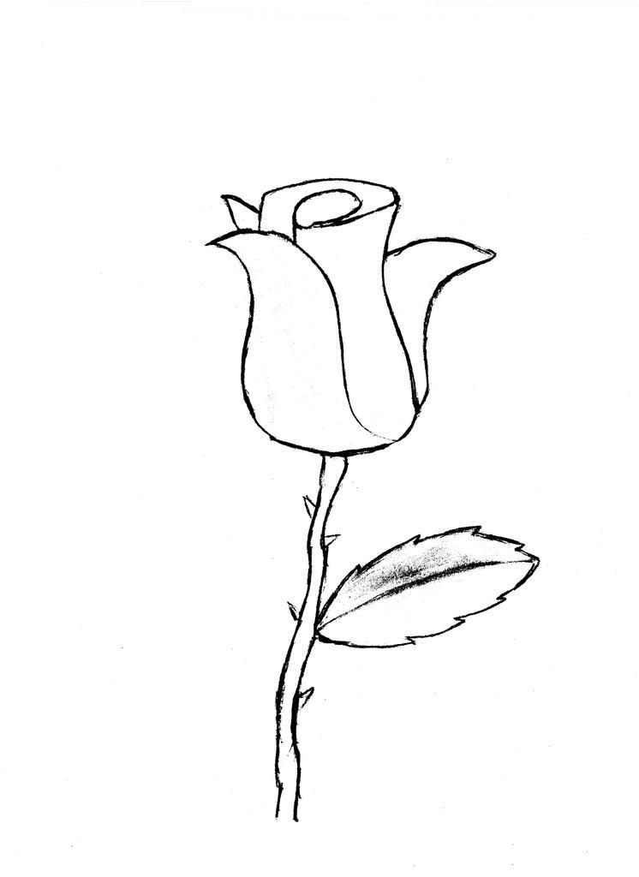
A Pattern for Future Believers
1 Tim 1:15 This is a faithful saying and worthy of all acceptance, that Christ Jesus came into the world to save sinners, of whom I am chief. 16 However, for this reason I obtained mercy, that in me first Jesus Christ might show all longsuffering, as a pattern to those who are going to believe on Him for everlasting life.
We imitate God so we can be a pattern for the lost
“Pattern” – to draw out a sketch or draft for a painter to begin
Why only a sketch? The H.S. will create the masterpiece.
Evangelism by example (you mean we can’t just preach it?)

Slide 22
“Become” an Example
1 Tim 4:6 If you instruct the brethren in these things, you will be a good minister of Jesus Christ, nourished in the words of faith and of the good doctrine which you have carefully followed. 7 But reject profane and old wives' fables, and exercise yourself toward godliness. 8 For bodily exercise profits a little, but godliness is profitable for all things, having promise of the life that now is and of that which is to come. 9 This is a faithful saying and worthy of all acceptance. 10 For to this end we both labor and suffer reproach, because we trust in the living God, who is the Savior of all men, especially of those who believe. 11 These things command and teach. 12 Let no one despise your youth, but be an example to the believers in word, in conduct, in love, in spirit, in faith, in purity. 13 Till I come, give attention to reading, to exhortation, to doctrine. 14 Do not neglect the gift that is in you, which was given to you by prophecy with the laying on of the hands of the eldership. 15 Meditate on these things; give yourself entirely to them, that your progress may be evident to all. 16 Take heed to yourself and to the doctrine. Continue in them, for in doing this you will save both yourself and those who hear you.

Slide 23
“Become” an Example cont.
Instruct, command, teach (vs 6, 11)
Be an example, progress evident to all (vs 11, 15)
Save those who hear (vs 16)
Instruction with example is powerful enough to save (convince)
Key to success: vs 15
“Meditate on these things”
“Give yourself entirely to them”
Until we “become” the example, we cannot “be” the example
Don’t take advice from those fail to demonstrate their mastery of the topic
Marriage counselor, financial advisor, fitness trainer examples
Practice what you preach
Timothy “became” that example (next slide)

Slide 24
Corinth gets a personal tutor
1 Cor 4:16 Therefore I urge you, imitate me. 17 For this reason I have sent Timothy to you, who is my beloved and faithful son in the Lord, who will remind you of my ways in Christ, as I teach everywhere in every church.
Paul left an example for Corinth (“imitate me”)
Timothy sent to further demonstrate Paul’s example
Implies that Paul mentored Timothy extensively; he became an example worthy of an apostle

Slide 25
Eph 5:1-2 Summary
Imitate God by following
His Son
His Spirit
His Apostles
His Word (by implication)
Why Imitate God?
He commands it
for His Glory
with His light (not our own)
to be a pattern for the lost
Examples were intentionally given for learning
Walk in Love! Toward God and toward others

